Slide 1
Meeting Agenda
February 26, 2020

Slide 2
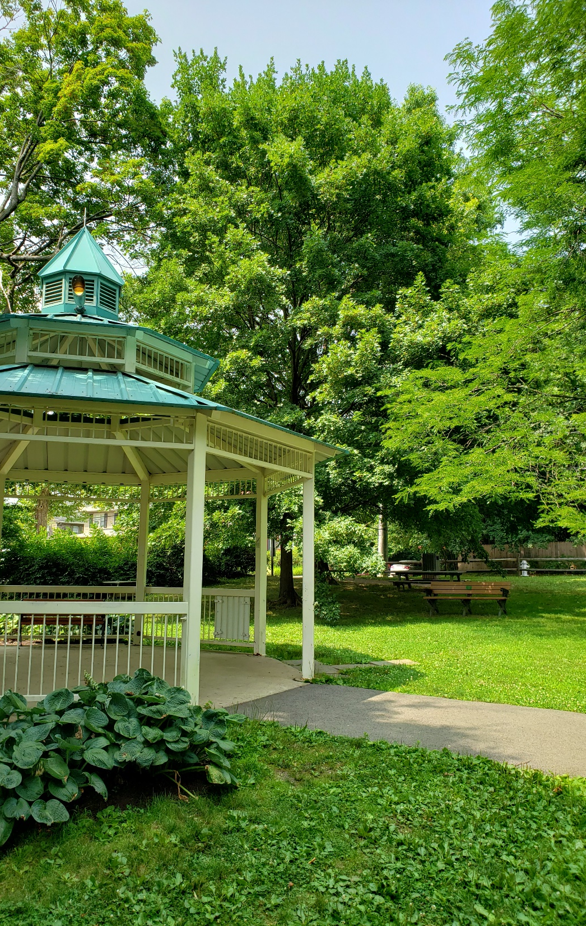
One of only 3
GOLD communities
in MontCo.
AGENDA
Welcome Members & Guests
Approval of 2019 & 1/22/20 Minutes
Presentations:
Springfield Twp.’s Sustainable PA Certification Results
Governance | 37 points
Health | 14 points
Diversity | 11 points
Education | 7 points
Energy | 30 points
Environment | 27 points
Housing | 11 points
Land use | 40 points
TOP 3 SUBCATEGORIES
Land Use: Community
Environment: Water
Governance: Operations
BOTTOM 3 SUBCATEGORIES
Governance: Sustainability
Energy Use: Municipal Use
Land Use: Waste & Recycling

Slide 3
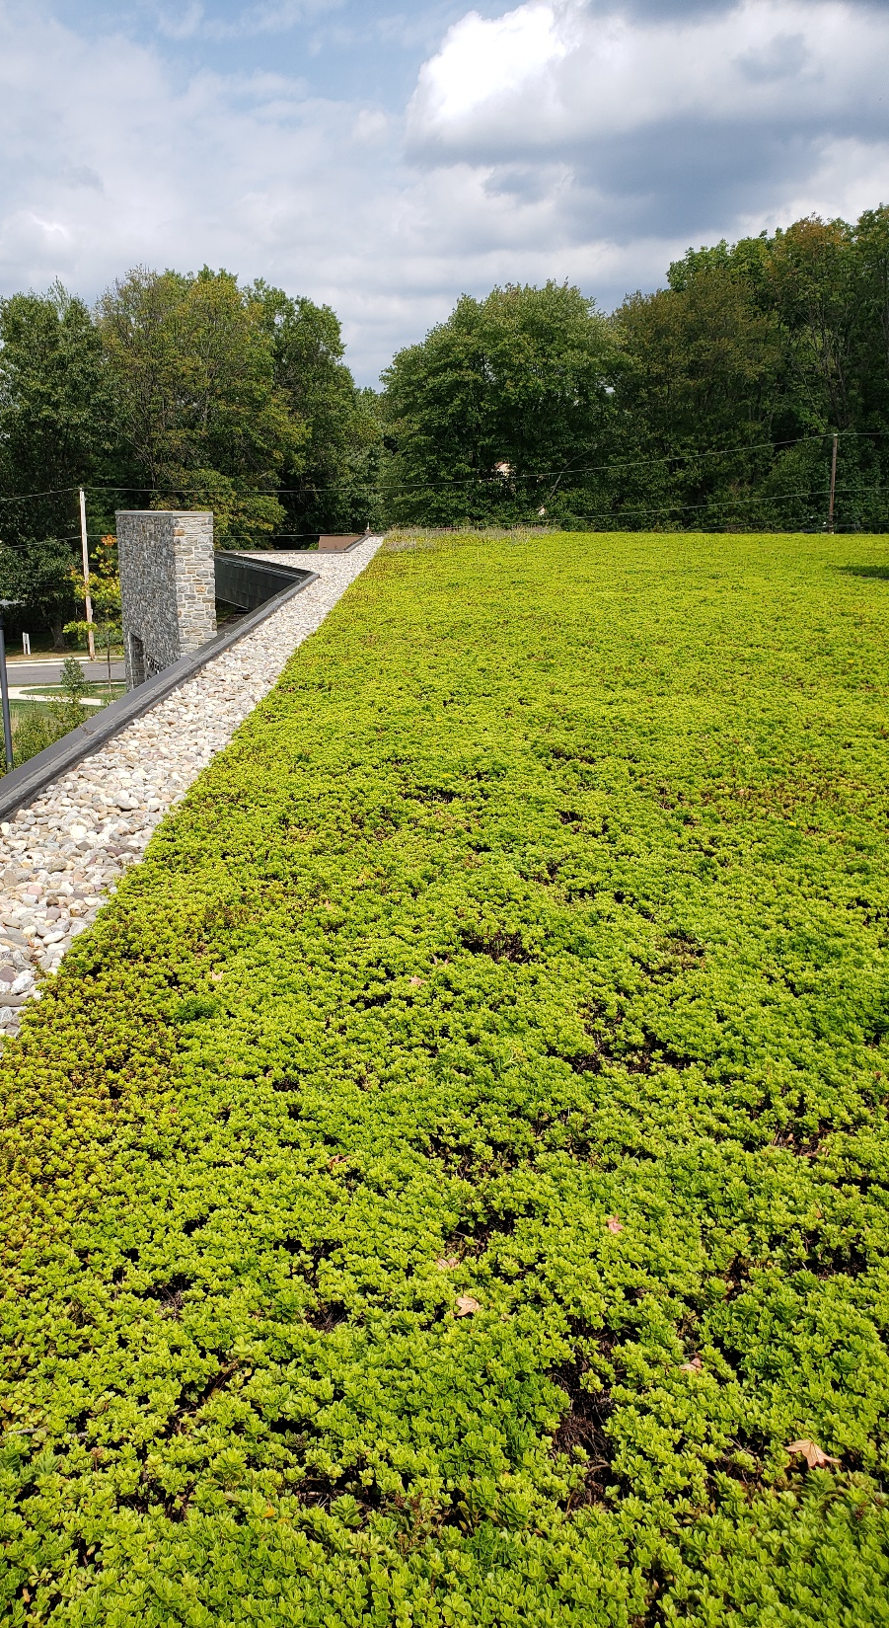
AGENDA
Commissioner Update
Energy Consulting Services Agreement
Township Solicitor Interviews
Township Staff Update
New Curbside Residential Leaf Collection
Regional Resiliency Partnership
Springfield Twp.’s NEW WEBSITE
Partner Update/Community Open Forum:
1.22.20

Slide 4
AGENDA
Old Business:
EAC Mailing List, Social Media, & Google Doc
Arbor/Earth Day (Sat. 4/25)
Sending Rep. to Shade Tree - 2/27
2020 Workshops
RF 100 Update
New Business
Recommendations on Associate Members
Climate Panel Hosted by Penn Environment
EAC Conference – Registering and attendance
1.22.20

